Slide 1
Design Changes – CWSN Vertical
Table of Contents
Date 06 – 12 – 2022

Slide 2
Changes to be incorporated
Url of the staging server https://preprod.ntp.net.in/cwsn.html
The placement of the thumbnails has to be changed as mentioned in ppt.
Add new thumbnail namely “ISL Resources”(graphics attached in the e mail)
Addition of the logo to the page (graphics attached in the e mail)
Please follow the instructions as mentioned in upcoming slides

Slide 3
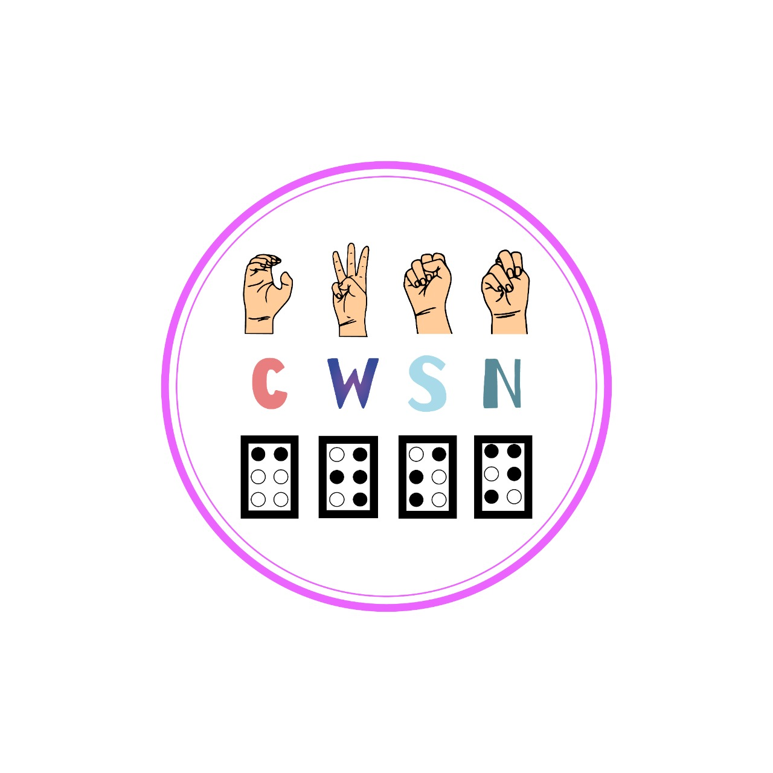
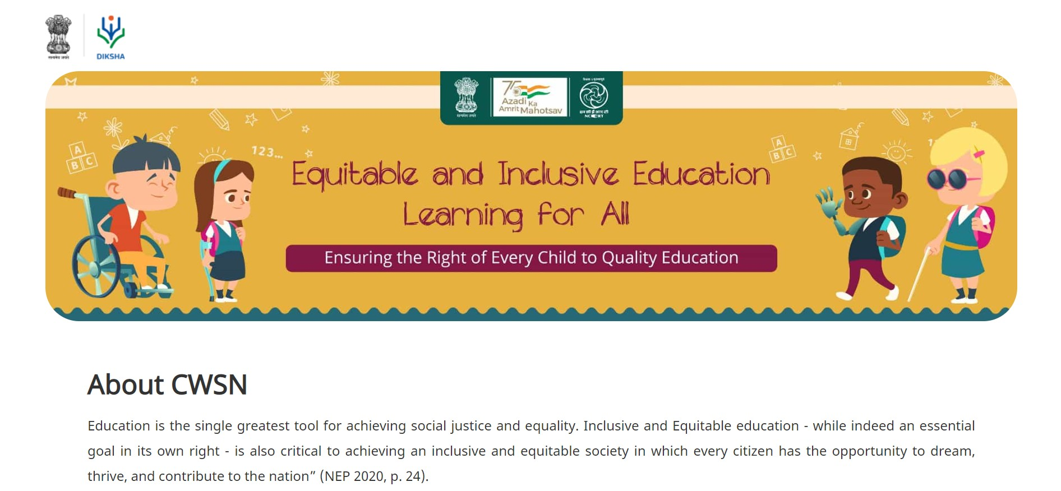
Addition of the CWSN LOGO

Slide 4
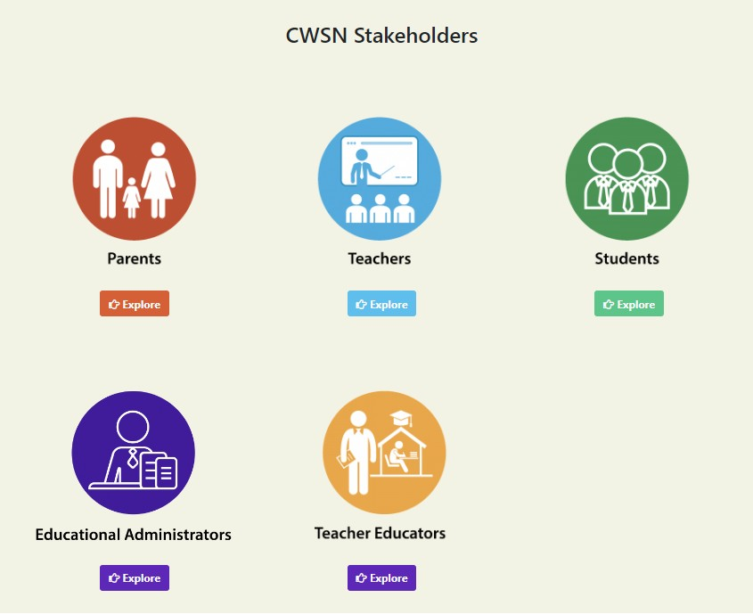
Revised design of the thumbnails
The layout has to be changed as mentioned below
Remove the thumbnails ISL Dictionary & Glossary in ISL.
New thumbnail namely “ISL Resources” highlighted in yellow to be added.
Resources mapped with thumbnails ISL Dictionary & Glossary in ISL to be mapped with ISL Resources
(First Row)
Parents
Teachers
Students
Teacher
Educators
Educational administrators
ISL Resources
(Second Row)

Slide 5


New Thumbnail – ISL Resources
Dictionary
Glossary
Academic Terms
A B C D E F G H I J K L M
N O P Q R S T U V W X Y Z
History
Economics
Geography
Urdu
Sociology
Psychology
A B C D E F G H I J K L M
N O P Q R S T U V W X Y Z
By clicking on the explore button a list will get open below wherein the list of three options will be visible i.e Dictionary, Glossary & Academic terms
Clicking on the Dictionary will take the user to the alphabet list A-Z wherein each letter is hyperlinked.
Clicking on Glossary will take the user to the list of subjects, clicking on each subject alphabet list A-Z will open
Academic terms will also be hyperlinked and Do IDs to map with this option will be shared soon

Slide 6
Thanks …!!

